Slide 1
CSS SELECTORS
CSS selectors are used to "find" (or select) the HTML elements you want to style.
We can divide CSS selectors into five categories:
Simple selectors (select elements based on name, id, class)
Combinator selectors (select elements based on a specific relationship between them)
Pseudo-class selectors (select elements based on a certain state)
Pseudo-elements selectors (select and style a part of an element)
Attribute selectors (select elements based on an attribute or attribute value)

Slide 2
CSS SIMPLE SELECTORS
1. The CSS element Selector
The element selector selects HTML elements based on the element name.
2. The CSS class Selector
The class selector selects HTML elements with a specific class attribute.
To select elements with a specific class, write a period (.) character, followed by the class name.

Slide 3
CSS SIMPLE SELECTORS
3. The CSS id Selector
The id selector uses the id attribute of an HTML element to select a specific element.
The id of an element is unique within a page, so the id selector is used to select one unique element!
To select an element with a specific id, write a hash (#) character, followed by the id of the element.
4. The CSS Universal Selector
The universal selector (*) selects all HTML elements on the page.

Slide 4
CSS SIMPLE SELECTORS
5. The CSS Grouping Selector
The grouping selector selects all the HTML elements with the same style definitions.
Look at the following CSS code (the h1, h2, and p elements have the same style definitions):

Slide 5
HOW TO ADD CSS
When a browser reads a style sheet, it will format the HTML document according to the information in the style sheet.
Three Ways to Insert CSS
There are three ways of inserting a style sheet:
External CSS
Internal CSS
Inline CSS

Slide 6
HOW TO ADD CSS
External CSS
With an external style sheet, you can change the look of an entire website by changing just one file!
Each HTML page must include a reference to the external style sheet file inside the <link> element, inside the head section.
An external style sheet can be written in any text editor, and must be saved with a .css extension.
The external .css file should not contain any HTML tags.
Here is how the "mystyle.css" file looks:

Slide 7
HOW TO ADD CSS
Internal CSS
An internal style sheet may be used if one single HTML page has a unique style.
The internal style is defined inside the <style> element, inside the head section.
Inline CSS
An inline style may be used to apply a unique style for a single element.
To use inline styles, add the style attribute to the relevant element. The style attribute can contain any CSS property.

Slide 8
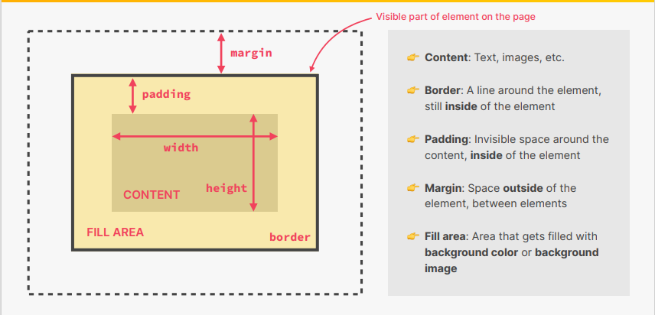
CSS BOX-MODEL

Slide 9
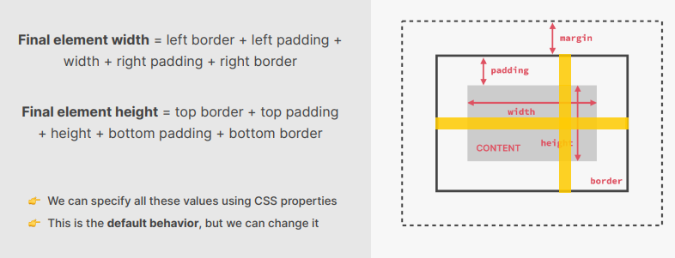
ELEMENT HEIGHT AND WIDTH CALCULATION

Slide 10

CSS BOX-MODEL
Box-sizing: content-box;
Width =20px +50px + 300px 50px +20px = 440px
Box-sizing: border-box;
Width =300px

